Slide 1

Hierarchical Time series
Aug 10, 2023

Slide 2
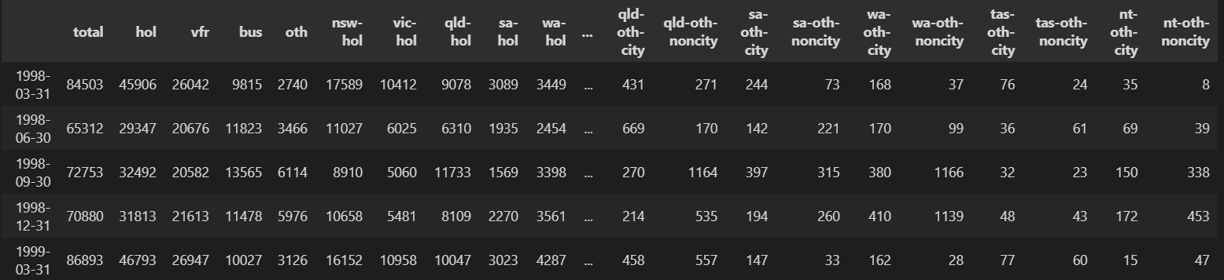
01. MODELING AND DATA
Level 1: 1 Time Series
T1
Level 2: 4 Time Series
T1
T2
T3
T4
Level 3: 28 Time Series – 7 TS by aggregation
T1
…
T7
…
T22
…
T28
7 Time Series
Level 4: 56 Time Series – 2 TS by aggregation
T1
…
T2
T55
…
T56
2 Time Series

Slide 3
Input
Layer
Hidden Layers
Output
Layer
Y1
X1
X2
X19
X20
 | Q1-1998 | Q2-1998 | Q3-1998 | … | Q3-2002 | Q4-2002
TS1 | 58462 | 25213 | 3221 | … | 2582 | 99533
TS2 | 65116 | 33225 | 33365 | … | 2256 | 3336
TS3 | 66522 | 33669 | 33366 | … | 3326 | 3336
TS4 | 5669 | 66524 | 3325 | … | 33669 | 3358
… | … | … | … | … | … | …
T89 | 66549 | 66589 | 85563 | … | 8546 | 2646
X1
Y2
X2
Y3
...
...
...
...
...
X19
Y87
X20
Y88
Y89

Slide 4
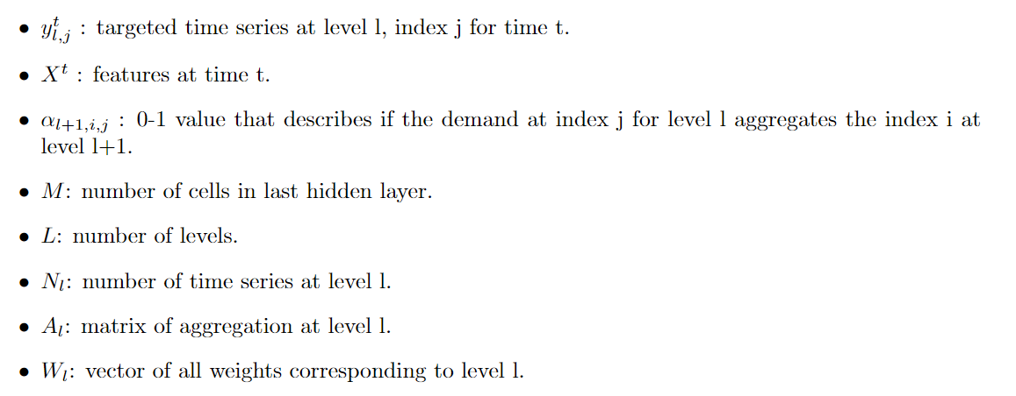
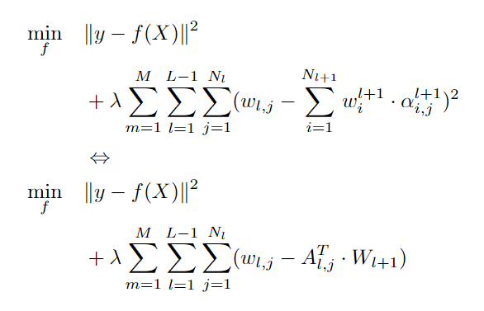
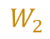

02. Loss function
A1 = [1, 1, 1, 1]
W1
$$W_{1}$$
A2 = [1, 1, …, 1, 1, 0, 0, …, 0, 0, 0, 0, …, 0, 0, 0, 0, …, 0, 0,
0, 0, …, 0, 0, 1, 1, …, 1, 1, 0, 0, …, 0, 0, 0, 0, …, 0, 0,
0, 0, …, 0, 0, 0, 0, …, 0, 0, 1, 1, …, 1, 1, 0, 0, …, 0, 0,
0, 0, …, 0, 0, 0, 0, …, 0, 0, 0, 0, …, 0, 0, 1, 1, …, 1, 1]
W1
W2
W3
W4
$$W_{2}$$
W1
…
W7
…
W22
…
W28

Slide 5
03. RESULTS
 | Neural Network with reconciliation |  | Neural Network w/o reconciliation |  | DeepAR w/o reconciliation
 | wMAPE | RMSSE | wMAPE | RMSSE | wMAPE | RMSSE
Level 1 | 5.23% | 2.11 | 6.03% | 3.13 | 14.56% | 8.51
Level 2 | 9.73% | 4.61 | 9.69% | 5.73 | 17.87% | 15.91
Level 3 | 15.54% | 52.30 | 15.94% | 60.24 | 21.74% | 171.45
Level 4 | 18.04% | 21.31 | 18.29% | 22.30 | 24.24% | 28.14
Global | 12.13% | 20.08 | 12.49% | 22.85 | 19.60% | 56.00

